Slide 1
Weekly Report
Jeewon, Yoon
2021/10/18
Last Week
Imaging Genetics Organizing behavior data to perform dimensionality reduction (Test scores related with Mental Health) Re-checked the code and evaluated it line by line. Data scaling using Yeo-Johnson Transform
Interesting Finding
Before doing dimensionality reduction the data needs to be scaled in order to get better results.
The aim of this month
Imaging Genetics Organizing datasets related with categorization for CPM prediction Apply the dataset to Neural Network and compare the accuracy with CPM
‹#›
Notes:
‹#›

Slide 2
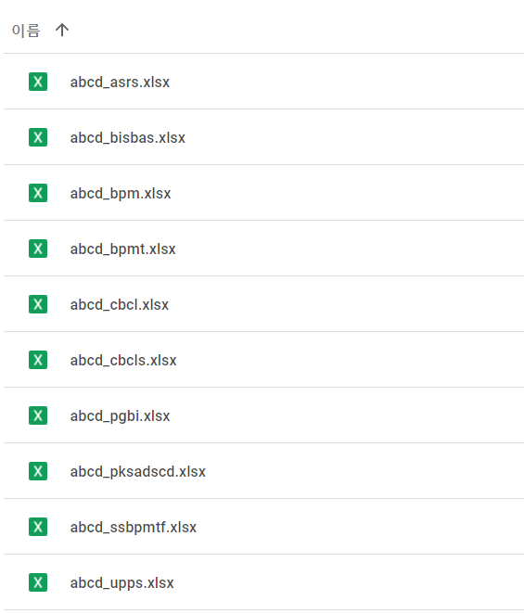
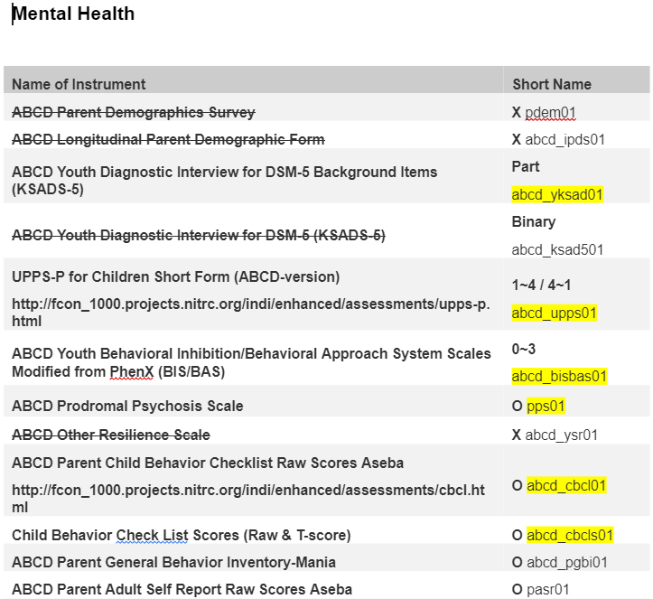
Imaging Genetics
Clinical test data Organization
  Grouping questionnaires(labeling) into appropriate category
  Look for clinical data property and determine relevant category (Impulsivity, Inattention, Depression, etc.)
  Data scaling → Yeo-Johnson Transform to make data more Gaussian
‹#›
Notes:
‹#›

Slide 3
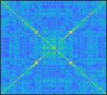
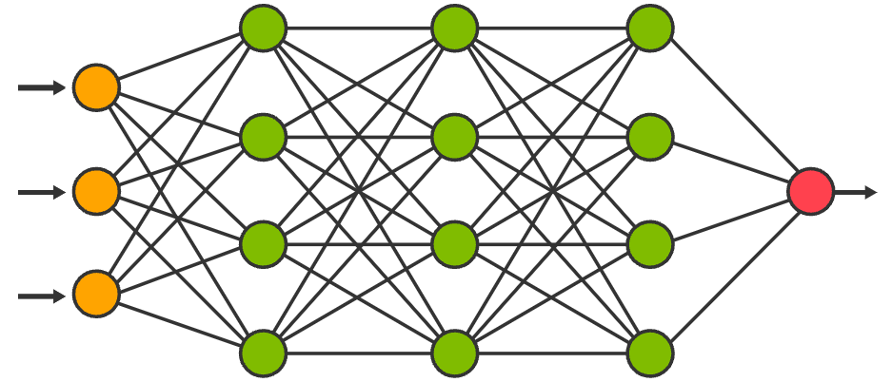
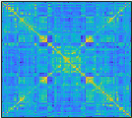
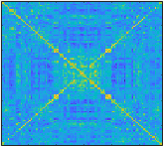
Imaging Genetics
Using Linear regression Neural Network
  What to address/Further works :
First, without feature selection(summation of selected FC edges’ weight), use all the FC and organized behavior score into the model and see the results.
Second, doing the same thing for the logistic regression network for symptom prediction.
Subjects’
Behavior
diagnosis
Score
OR

Slide 4
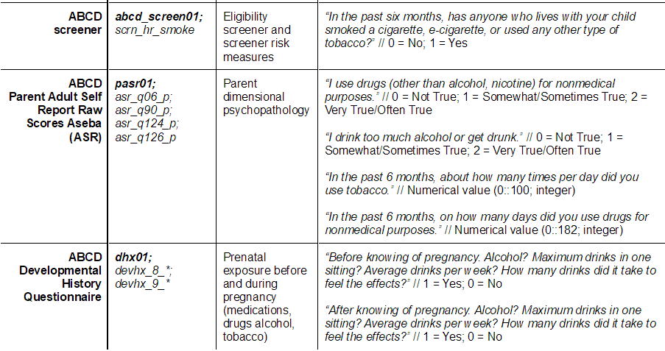
Weekly Report
This Week
Organize each questionnaires into appropriate categories. (Example: ABCD Substance Use)
‹#›
Notes:
‹#›

Slide 5
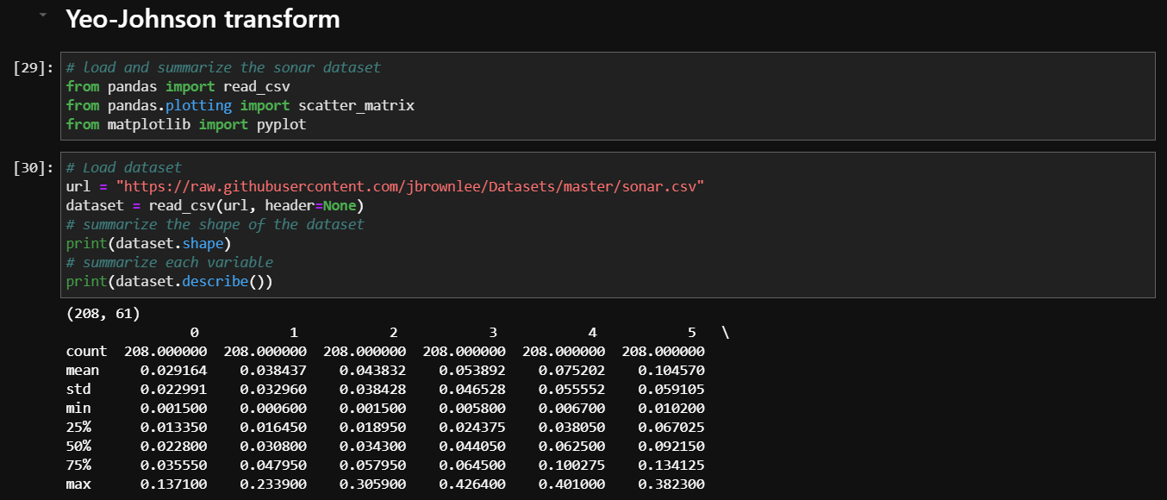
Weekly Report
This Week
Scale the organized data using Yeo-Johnson transform Behavior score matrix will be made for PCA analysis.
‹#›
Notes:
‹#›

Slide 6
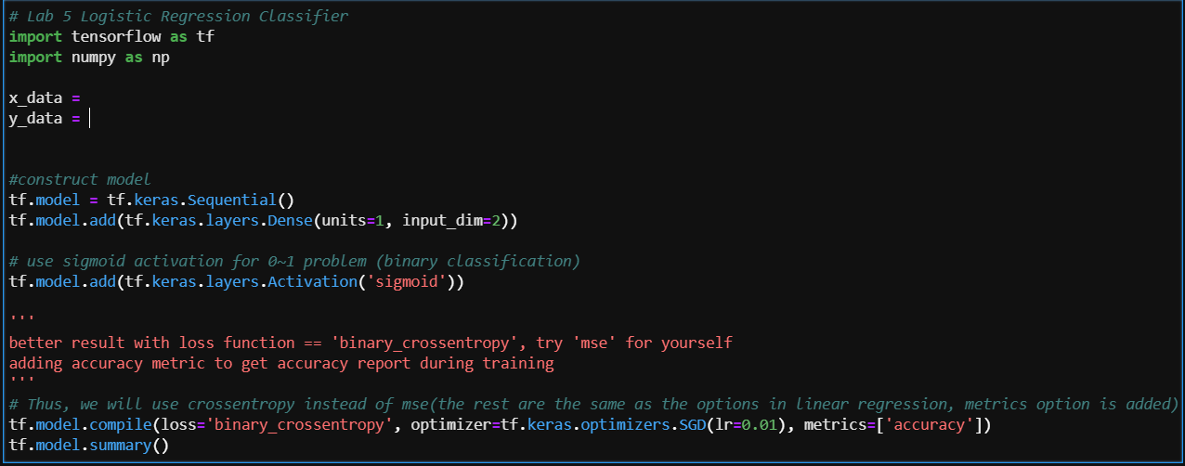
Weekly Report
This Week
Neural Network (simple linear regression & logistic regression) will be used. (Omitting Feature Selection → Using all the FC for Neural Network input value) Using less than 100~200 subjects to test the neural network’s performance at first.
‹#›
Notes:
‹#›

Slide 7
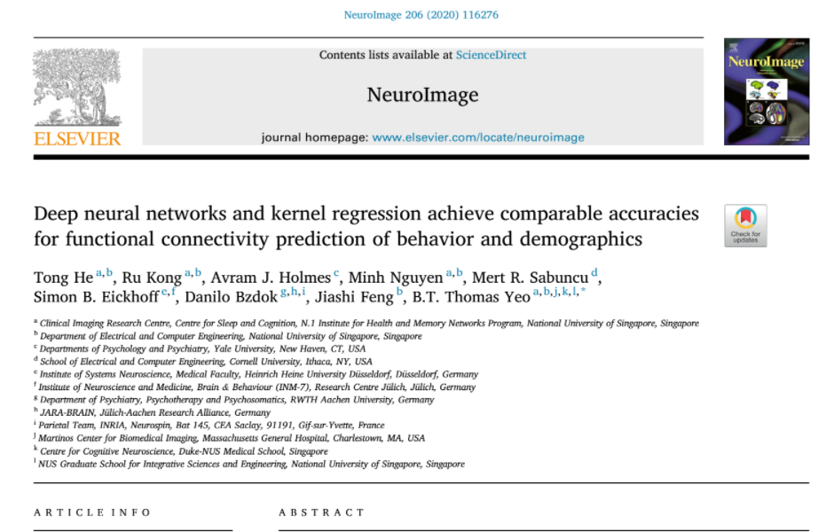
Supplementary Slides

